Slide 1


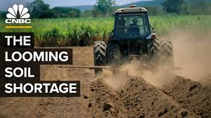

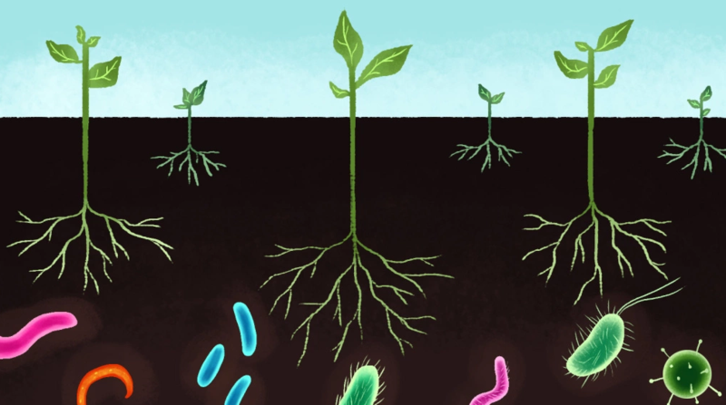
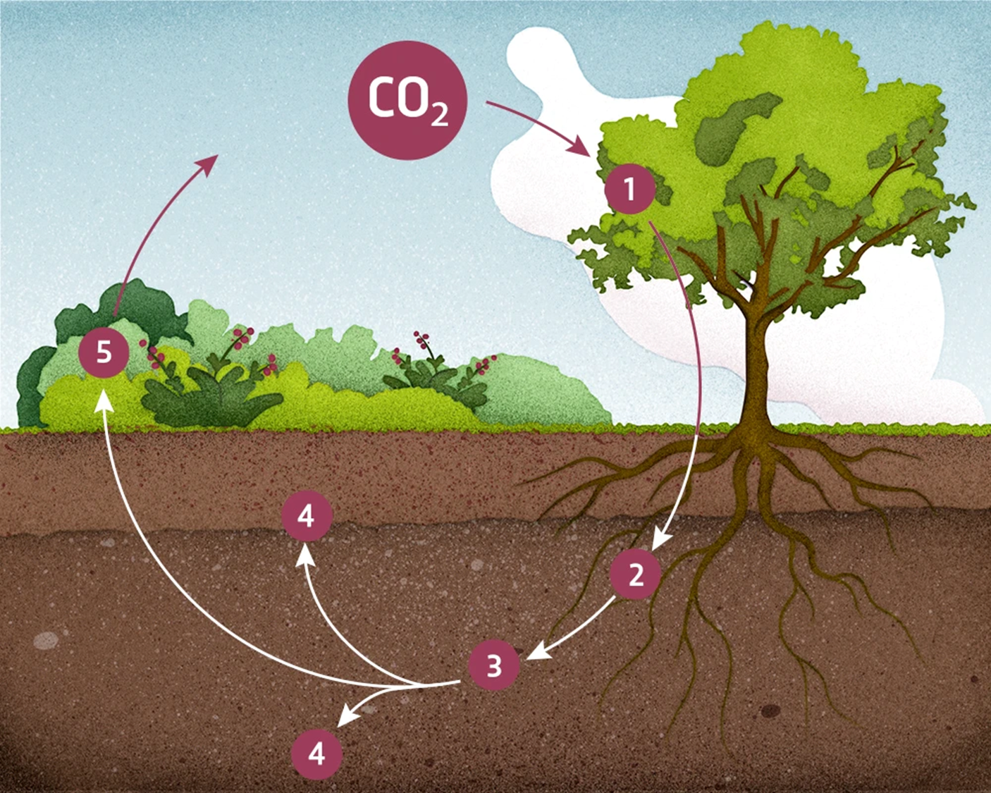
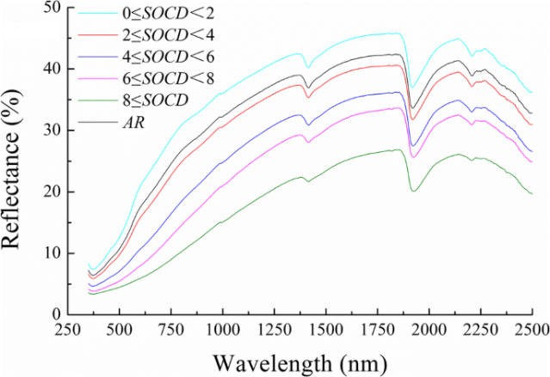
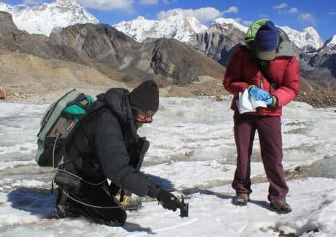
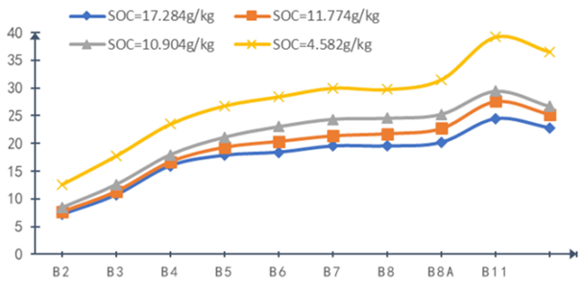
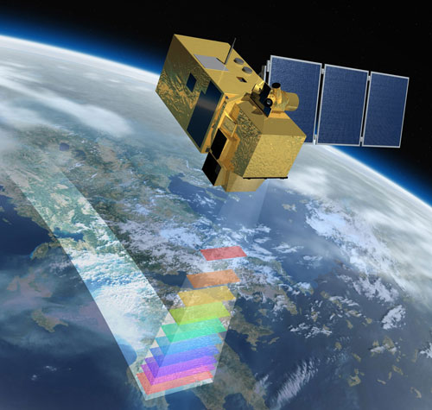
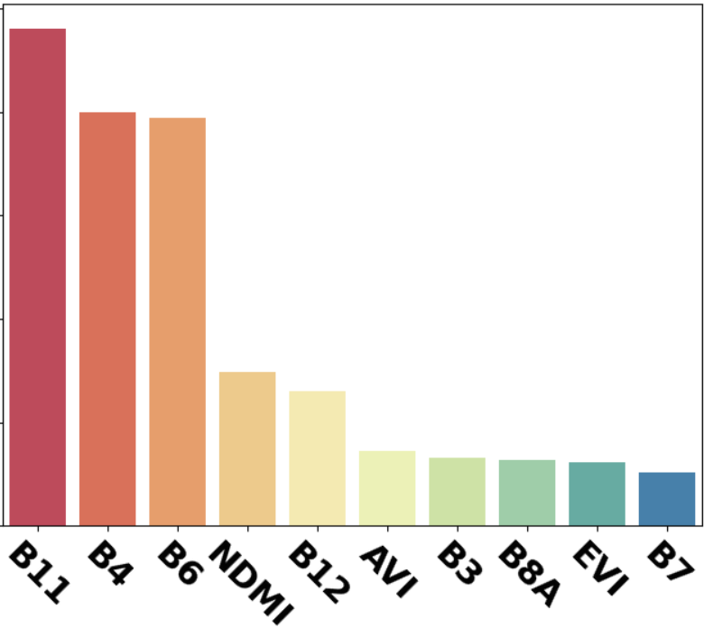
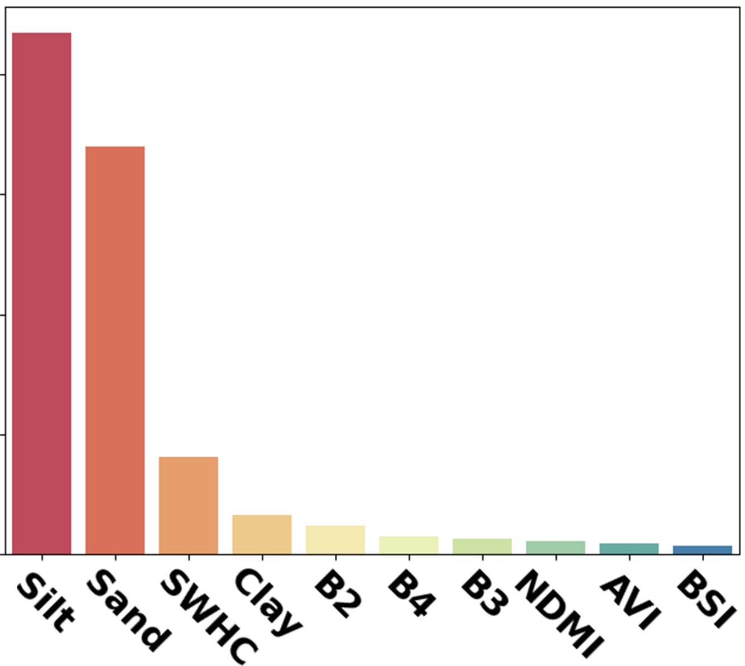
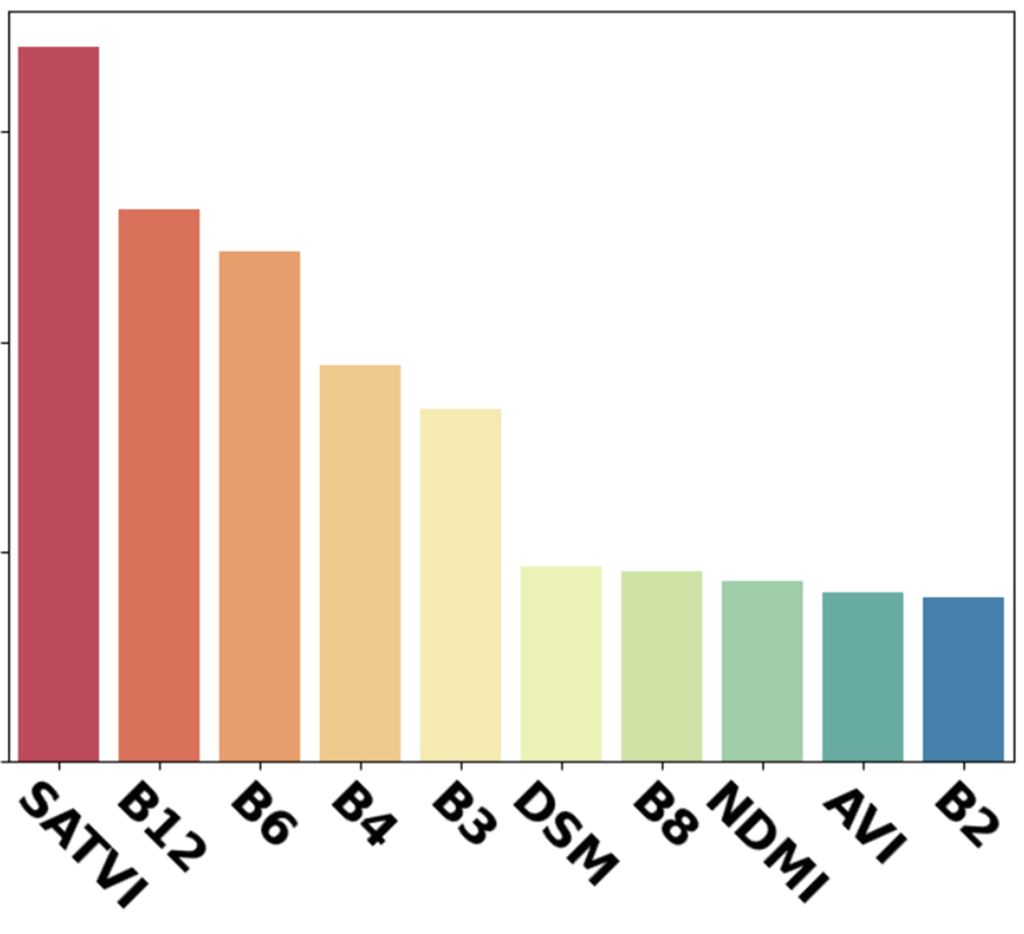
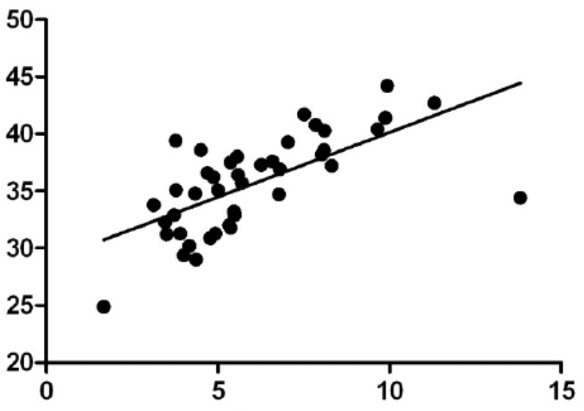
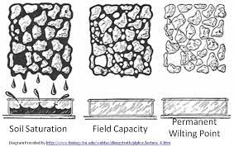
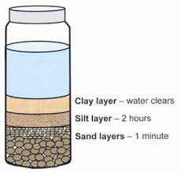
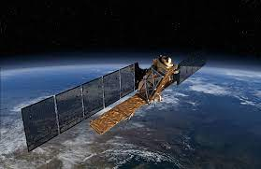
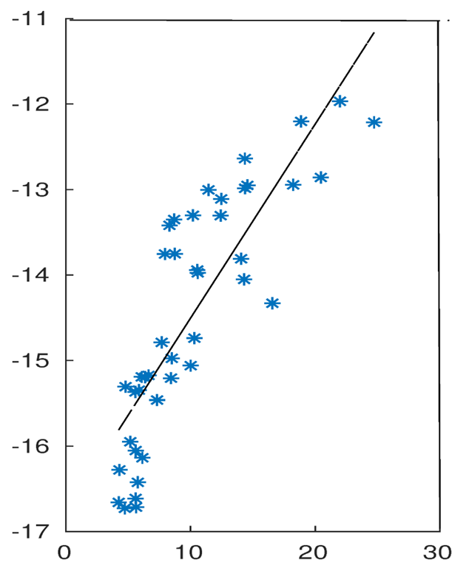
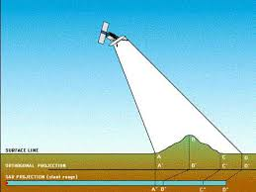
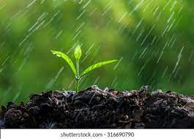
Practical Improvements of Soil Organic Carbon (SOC) Sensing with Machine Learning, Satellite and Ground Data
Dong-Yoon Kim¹, Woo-Young Park², Jin-Seong Kim³, Su-Min Oh⁴, Alfred Cueva⁵
¹Department of Physics and Astronomy, ²Department of Environmental Engineering, ³College of Liberal Studies, ⁴Department of Economics, ⁵Department of Mechanical Engineering, Seoul National University,1 Gwanak-ro, Gwanak-gu, Seoul 08826, Republic of Korea
Introduction
Importance of Soil Health and SOC
Global Issue of SOC degradation
95% of our food comes from topsoil
[20] Sustainable Land Use Management, 2017
[7] UNCCD, 2020
[21] National Crime Records Bureau, 2021
[1] UNFAO, 2019
Soil is the largest terrestrial carbon sink
[2] Global Change Bio, 1997
Unsustainable farming
Inadequate fertilizer
Overgrazing etc.
By 2050, likely 90% of global topsoil will degrade
Farmer suicide rate ↑↑↑ (300,000 in India alone) due to harvest < debt
Microbe biodiversity helps crop growth
[3] Plant Sci, 2017
Hence SOC sensing/monitoring is important because
Soil degradation prevention
Food security monitoring
Enforce pro-soil policy
But current method to measure SOC (Walkley-Black test) is too slow, uses dangerous chemicals
Need to cheaply monitor SOC at scale and at real-time
[22] Nature 601, 503-504 (2022)
[11] Soil & Man., 2007
Related Works
Results
c
Hand-held spectroradiometer
Trained only on Raw MSI Image (Resolution = 20m)
Models | SVM | PLSR | RF
Train R² | 0.22 | 0.48 | 0.70
Test R² | 0.21 | 0.30 | 0.52
MSI Image enhanced with Super-Resolution (Resolution = 10m)
Models | SVM | PLSR | RF
Train R² | 0.57 | 0.38 | 0.69
Test R² | 0.33 | 0.25 | 0.38
Optical Characteristic of SOC
Hi-Res NG
Spectroradiometer
[12] Int. Soil & Water Cons. Res. 2020
Reading Spectral Reflectance to determine SOC
Reflectance (%)
Spectroradiometer extremely expensive ~ $100,000
Common farmers cannot afford
Not a scalable solution
Random Forest (RF) model showed better accuracy than Support Vector Machine (SVM) & Partial Least-Squares Regression
Information loss in resolution enhancement as enhancement done based on only 4 bands out of 13 bands
Increase in SOC
Only MSI → RF
Approach 1
(MSI + SWHC + ST → RF)
Approach 2
(MSI + SAR → RF)
Wavelength (nm)
Multi-Spectral Imagery (MSI)
[13] Remote Sens. 2021
Scalable solution as Sentinel-2 images over entire Earth surface and open-source
Not accurate enough with R² = 0.57 between predicted and actual SOC
Reflectance (%)
Reflectance (%)
Increase in SOC
MSI
bands
Test R² = 0.52
Test R² = 0.83
Test R² = 0.74
B2
B3
B4
B5
B6
B7
B8
B8A
B11
B12
…
Sentinel-2 with revisit time of 5 days Imaging entire Earth
Similar results with previous works
60% Accuracy Increase
42% Accuracy Increase
Discrete bands instead of continuous spectrum
Our Strategy
Top 10 most important features for SOC prediction
Only MSI
Approach 1
Approach 2
Approach 1 (Hybrid Remote Sensing)
Feature Importance (a.u.)
*DSM = Delta Soil Moisture
SOC ↑↑↑ → Soil Water Holding Capacity (SWHC)↑↑↑
MSI
SWHC
Soil Texture
H₂O
ML regression model to accurately predict SOC level
SWHC (%)
+
+
Clay
Top 3 features have wavelengths 1610nm, 665nm, 740nm
Associated with SOC chemistry
Top 4 features show predictive power of ST and SWHC
ST importance > SWHC importance
SAR data has notable influence in prediction but less than expected due to influence of soil roughness
Silt
[14] Int. J. Ecol. Environ. Sci, 2009
SOC (%)
Sand
Simple, Cheap → Anyone (farmers etc.) can test
Approach 2 (Full Remote Sensing)
Conclusion
Sentinel-1 Synthetic Aperture Radar (SAR)
MSI
B4 rain
Rain
Aft rain
Approach 1 is cheap and easy able to accurately determine farmer’s SOC:
+
ML
Reg.
Practical Implementation:
Farmer measure ST and SWHC
Send data to operator
Add MSI data
SOC determined
Backscatter_{VV} (dB)
More accurate than just MSI
Approach 2 is less accurate than approach 1 but it is full-remote sensing → Robust means of global monitoring
Radar
Antenna
Difference of Soil Moisture before and after rain can give us idea how well soil retains water
Practical Implementation:
MSI + SAR
Global Monitoring
Danger Area Detected
Check with Approach 1
Surface
Soil Moisture (%)
Detect & Prevent soil degradation → Improve agriculture
Monitor soil carbon sequestration → Help mitigate climate change

